Slide 1

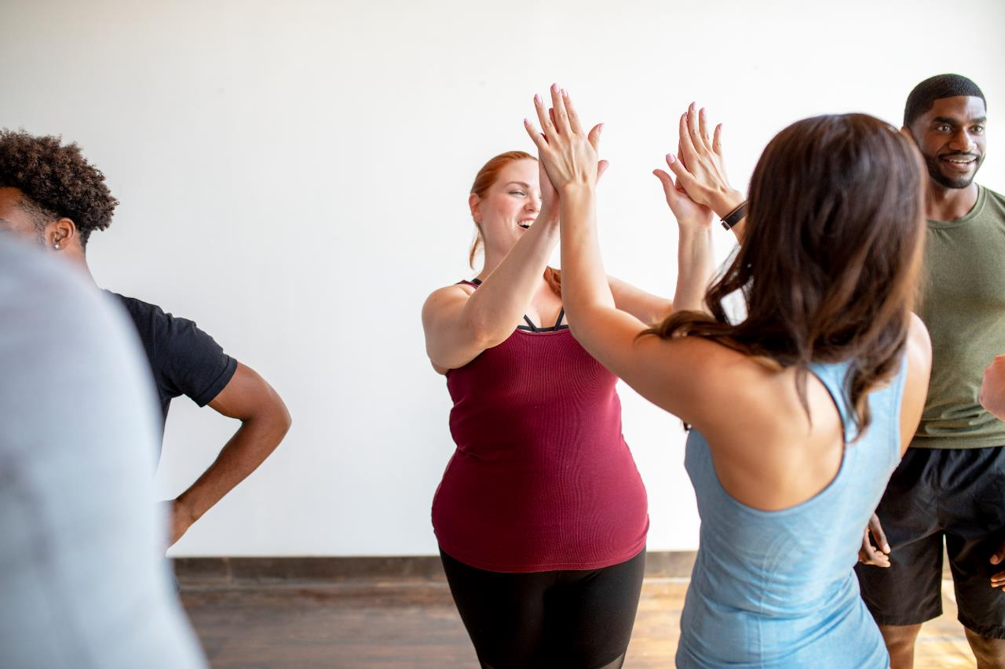

Thrive Together
Welcome to Burnalong
Physical
Financial
Emotional

Slide 2

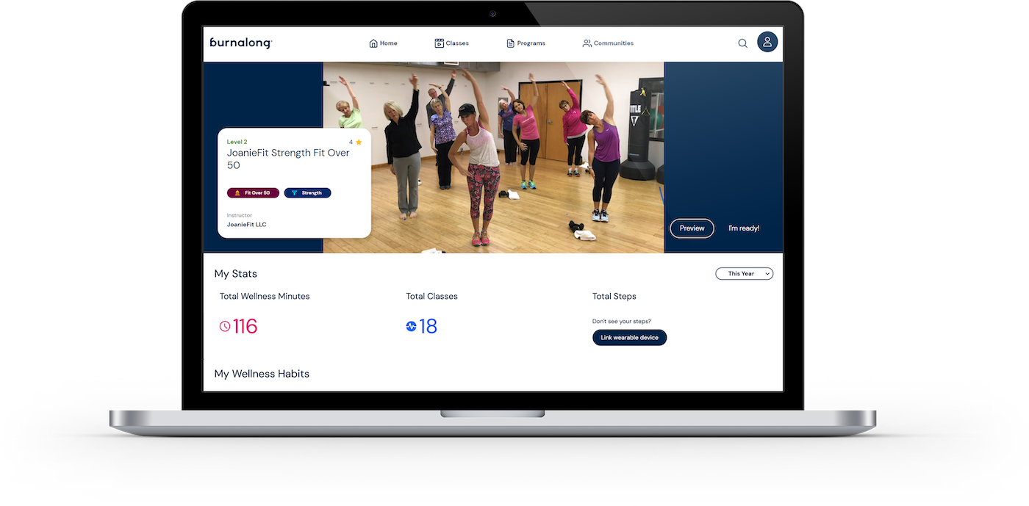



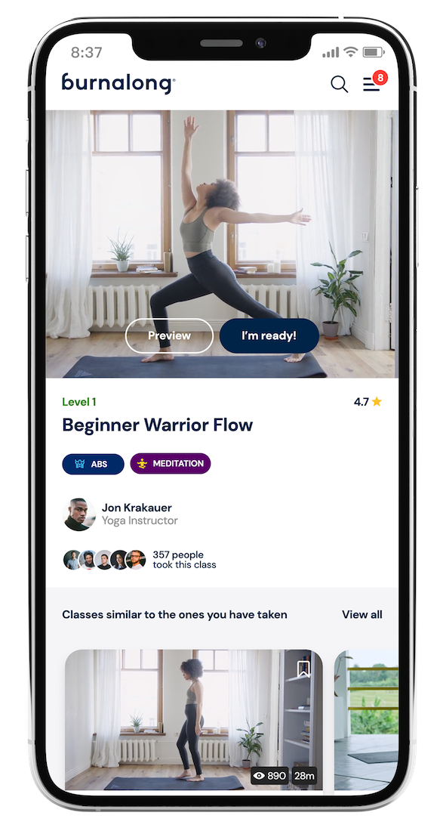

What is Burnalong?
Website:
well.burnalong.com
Mobile website: well.burnalong.com
App:
IOS & Android
50,000+ classes across health, wellness, fitness classes
On your phone (IOS & android), tablet, computer, or cast to your TV
© 2023 Burnalong, Inc. All rights reserved. Burnalong, Inc. Confidential & Proprietary.

Slide 3

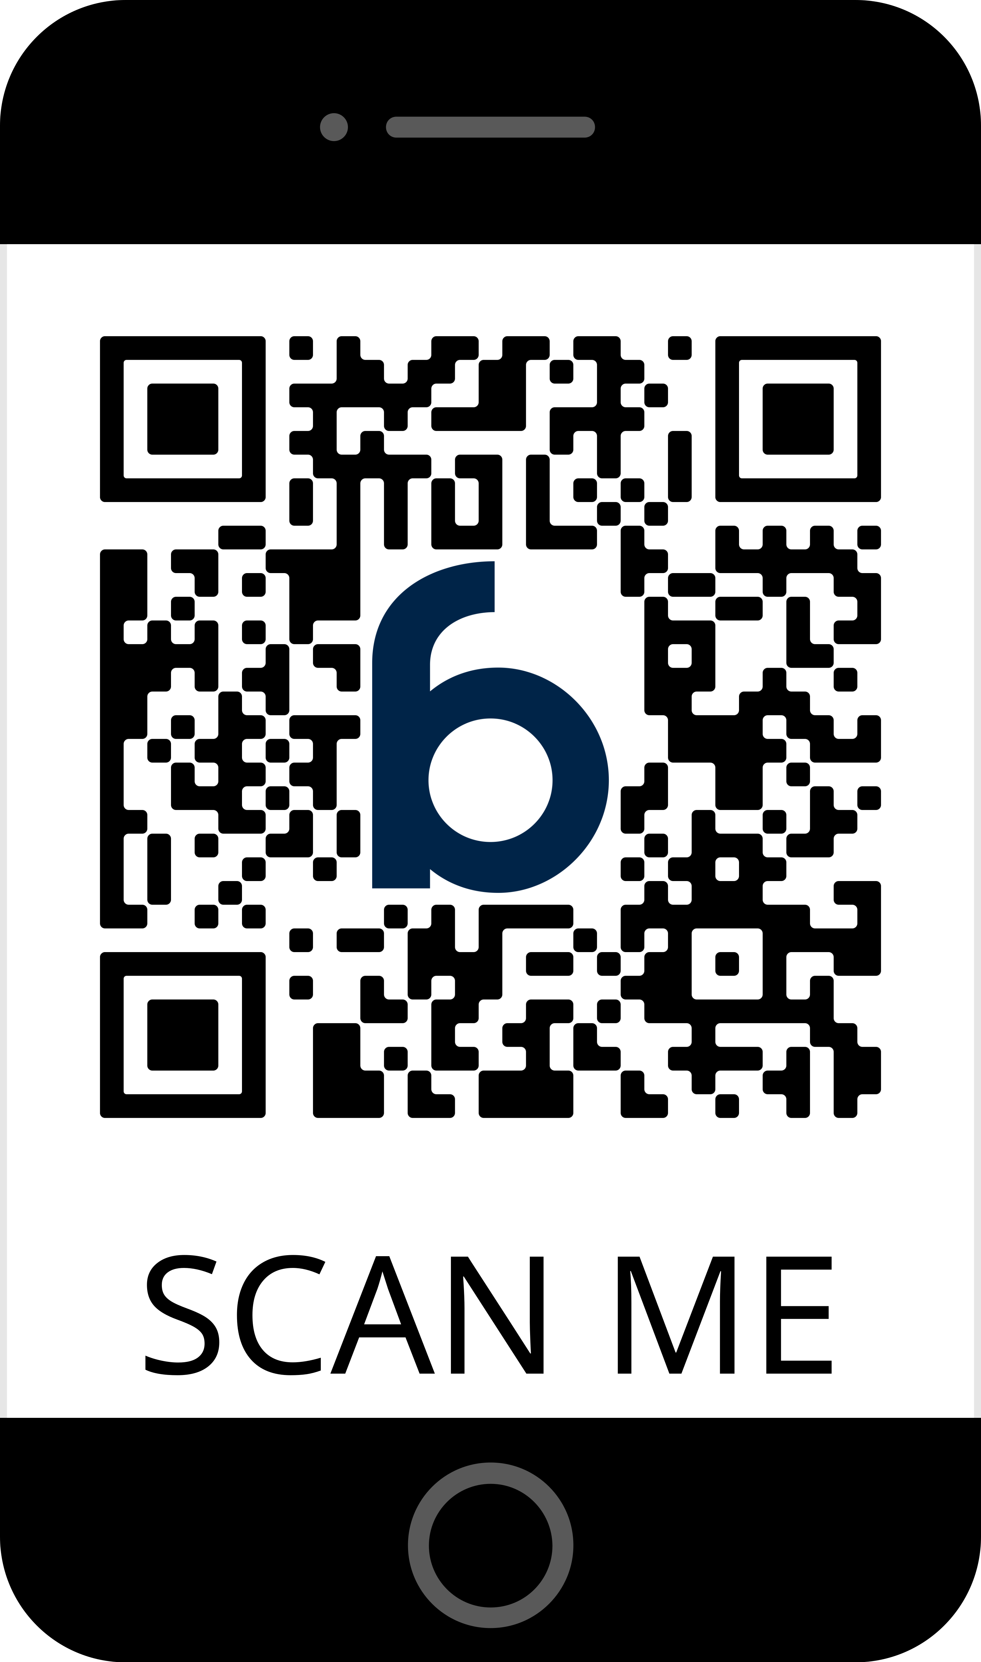
Create your account
https://join.burnalong.com/segal
© 2023 Burnalong, Inc. All rights reserved. Burnalong, Inc. Confidential & Proprietary.

Slide 4


Landing page
https://join.burnalong.com/segal
© 2023 Burnalong, Inc. All rights reserved. Burnalong, Inc. Confidential & Proprietary.

Slide 5

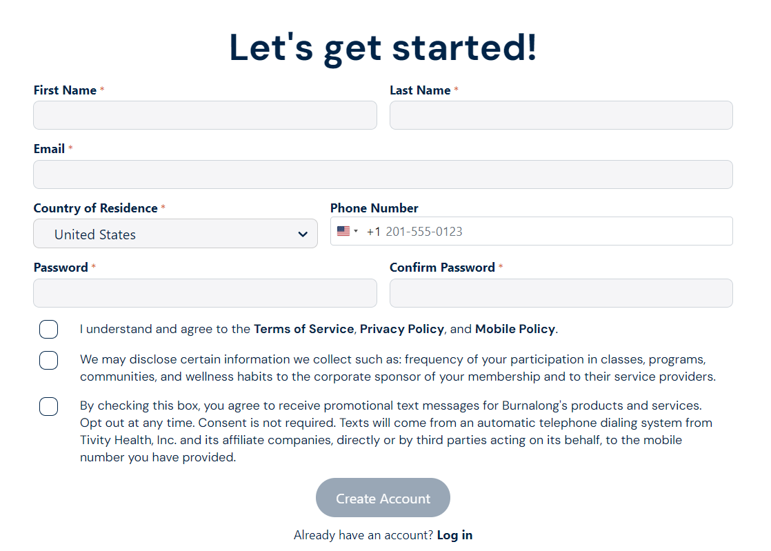
Registration page
https://join.burnalong.com/segal
© 2023 Burnalong, Inc. All rights reserved. Burnalong, Inc. Confidential & Proprietary.

Slide 6


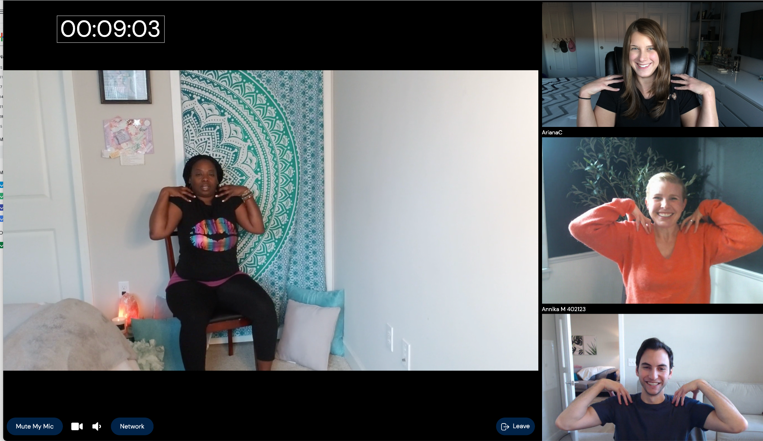
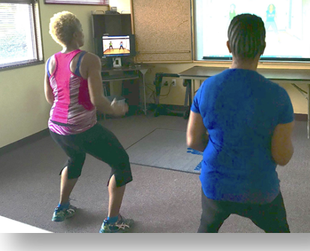
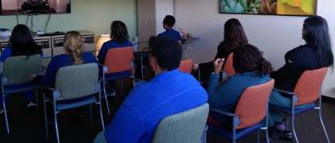
3 ways to take a class
Live at home with others
In-person with colleagues, friends, or family
Alone
© 2023 Burnalong, Inc. All rights reserved. Burnalong, Inc. Confidential & Proprietary.

Slide 7

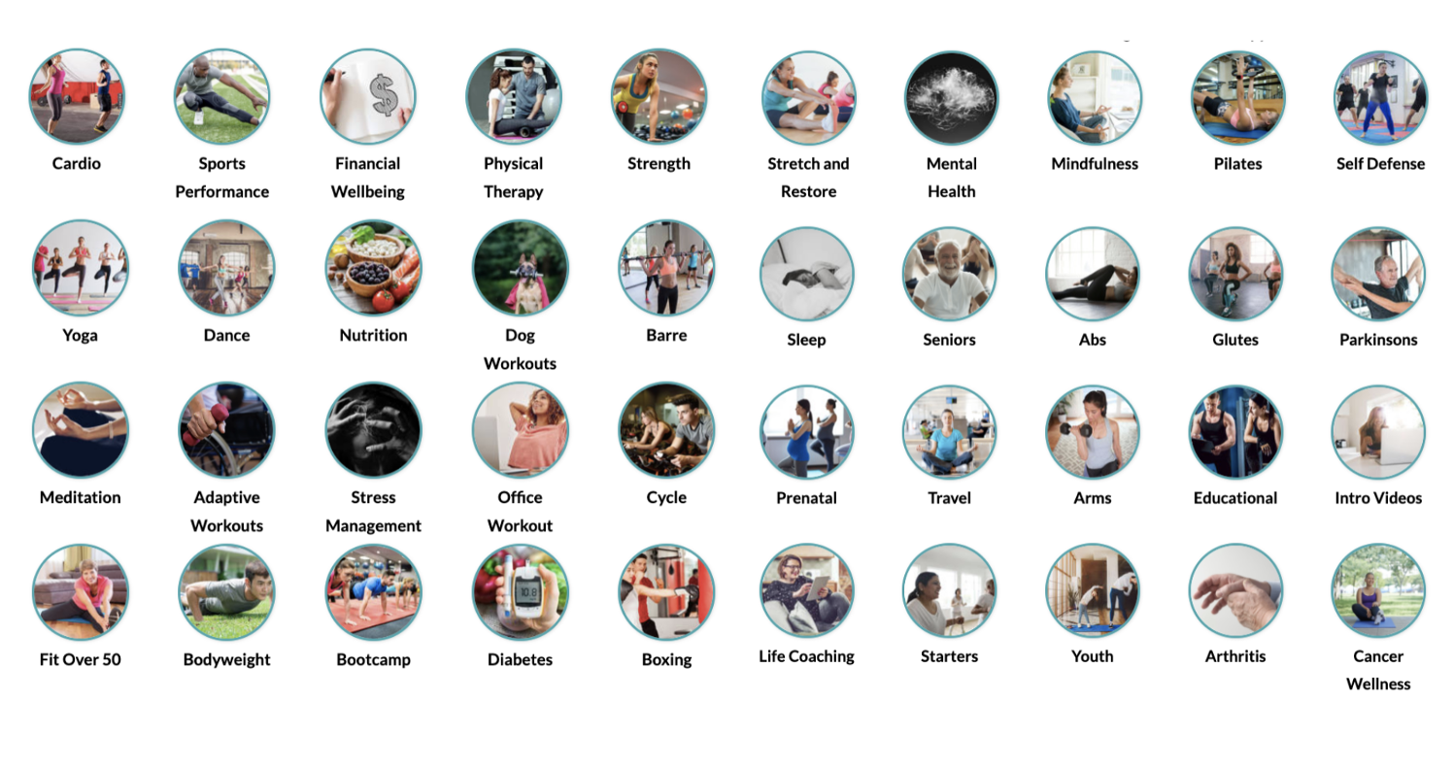
More choice, engagement, & authentic instructors
70+ categories covering every area of health and wellness
© 2023 Burnalong, Inc. All rights reserved. Burnalong, Inc. Confidential & Proprietary.

Slide 8

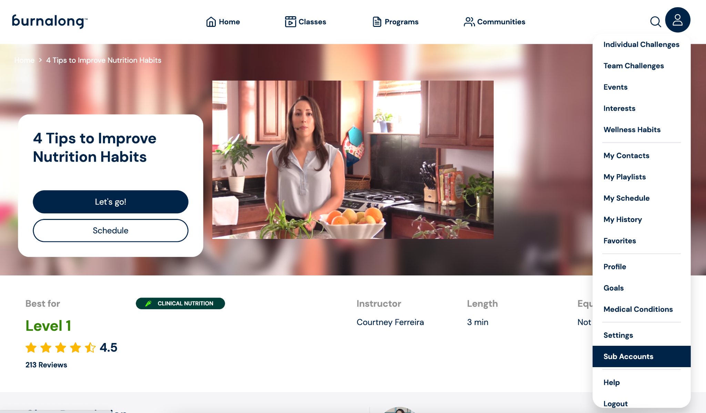
4 free sub-accounts
© 2023 Burnalong, Inc. All rights reserved. Burnalong, Inc. Confidential & Proprietary.

Slide 9

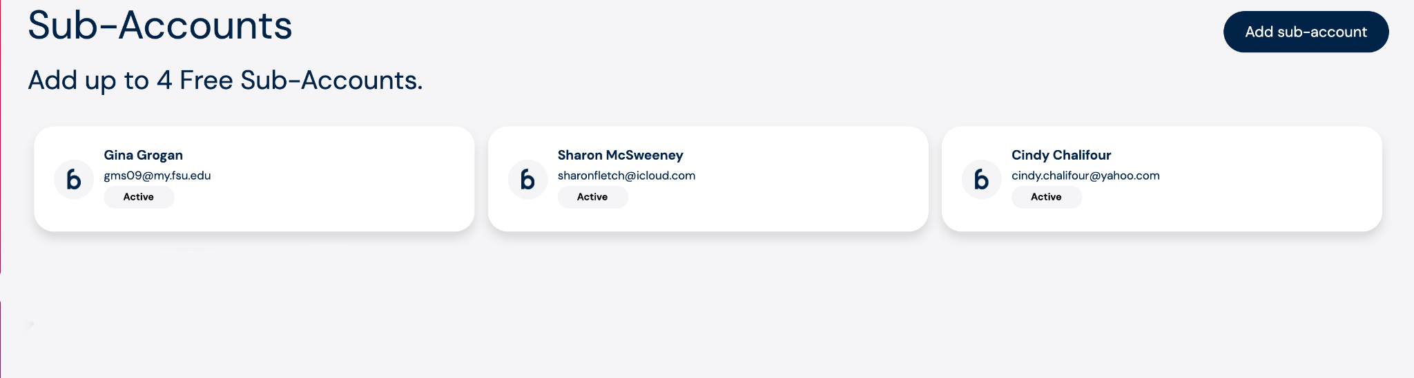
4 FREE SUB-ACCOUNTS

Slide 10
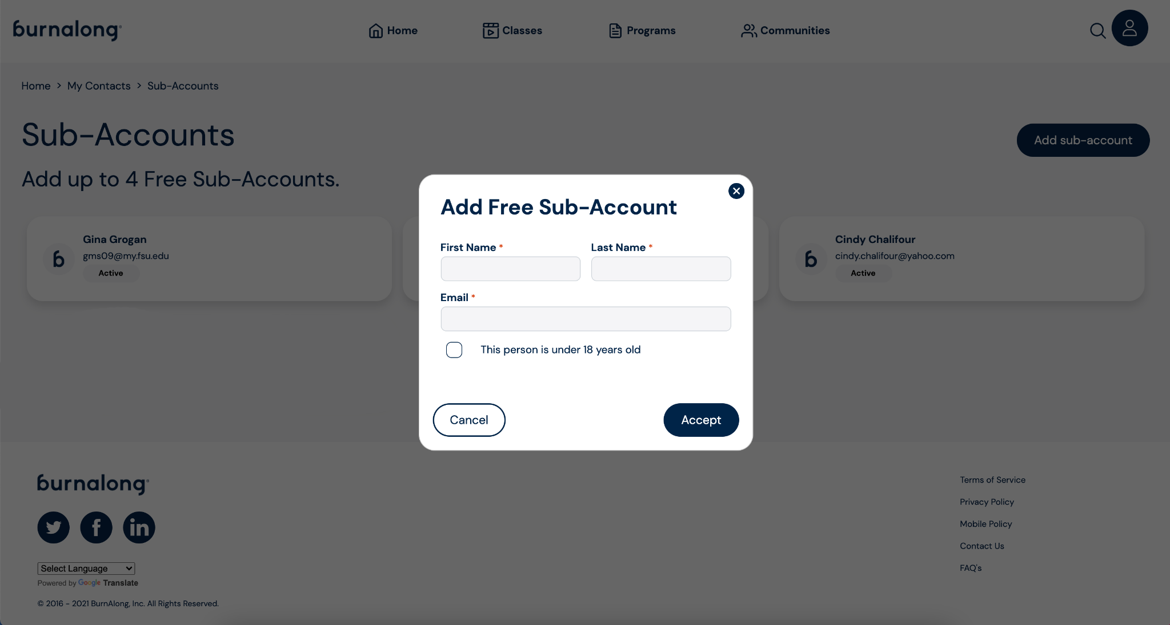
4 FREE SUBACCOUNTS

Slide 11

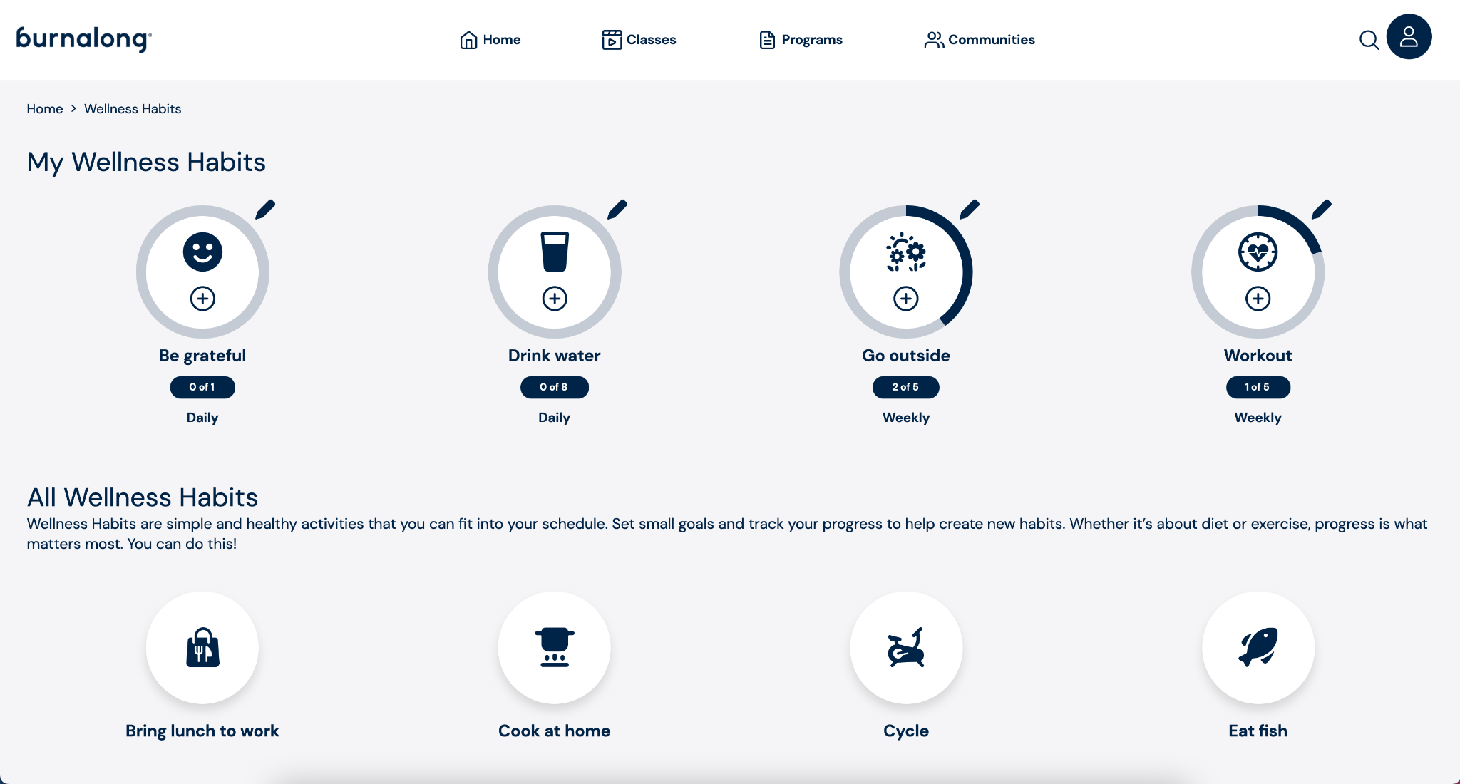
Wellness habits
© 2023 Burnalong, Inc. All rights reserved. Burnalong, Inc. Confidential & Proprietary.

Slide 12

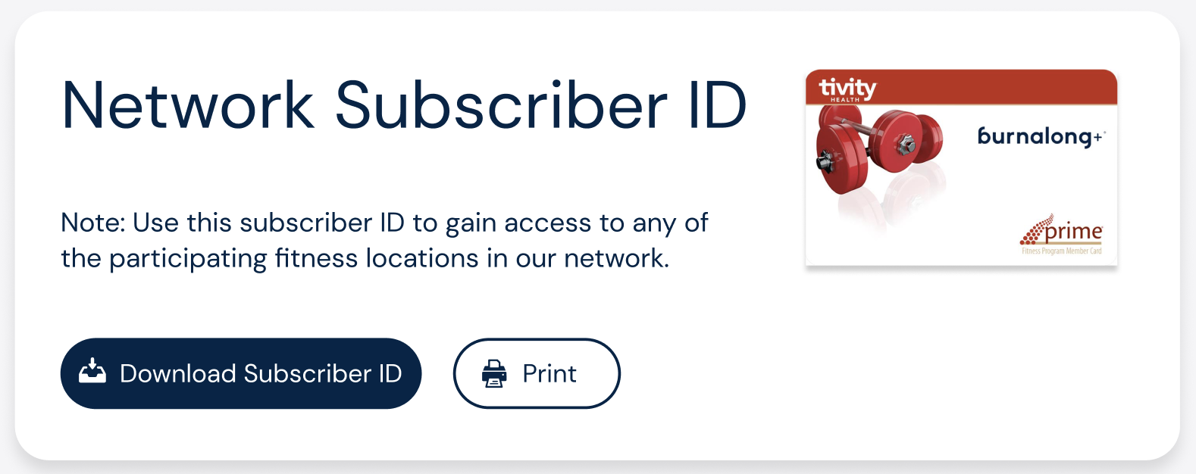


Upgrade to Burnalong+
With your Burnalong+ card, you get:
Access to 10,000+ locations
One monthly fee
Cancel anytime
burnalong®, Burnalong is a registered trademark of Burnalong, Inc. © 2024 Burnalong, Inc. All rights reserved. Confidential & Proprietary.

Slide 13




Access to 10,000+ locations
Variety in your wellness
Not tied to a membership
Great for when traveling
Hop around and see what works for you!
Monday
Wednesday
Friday
burnalong®, Burnalong is a registered trademark of Burnalong, Inc. © 2024 Burnalong, Inc. All rights reserved. Confidential & Proprietary.

Slide 14

One monthly fee
Thanks to your employer, you can upgrade to Burnalong+ for just
$29/month
Other gyms
$29/month
Any gym in the network, nationwide
No annual fee
No registration fee
Average cost is $35/month
Limited to one gym
Annual fees
Registration fees
burnalong®, Burnalong is a registered trademark of Burnalong, Inc. © 2024 Burnalong, Inc. All rights reserved. Confidential & Proprietary.

Slide 15

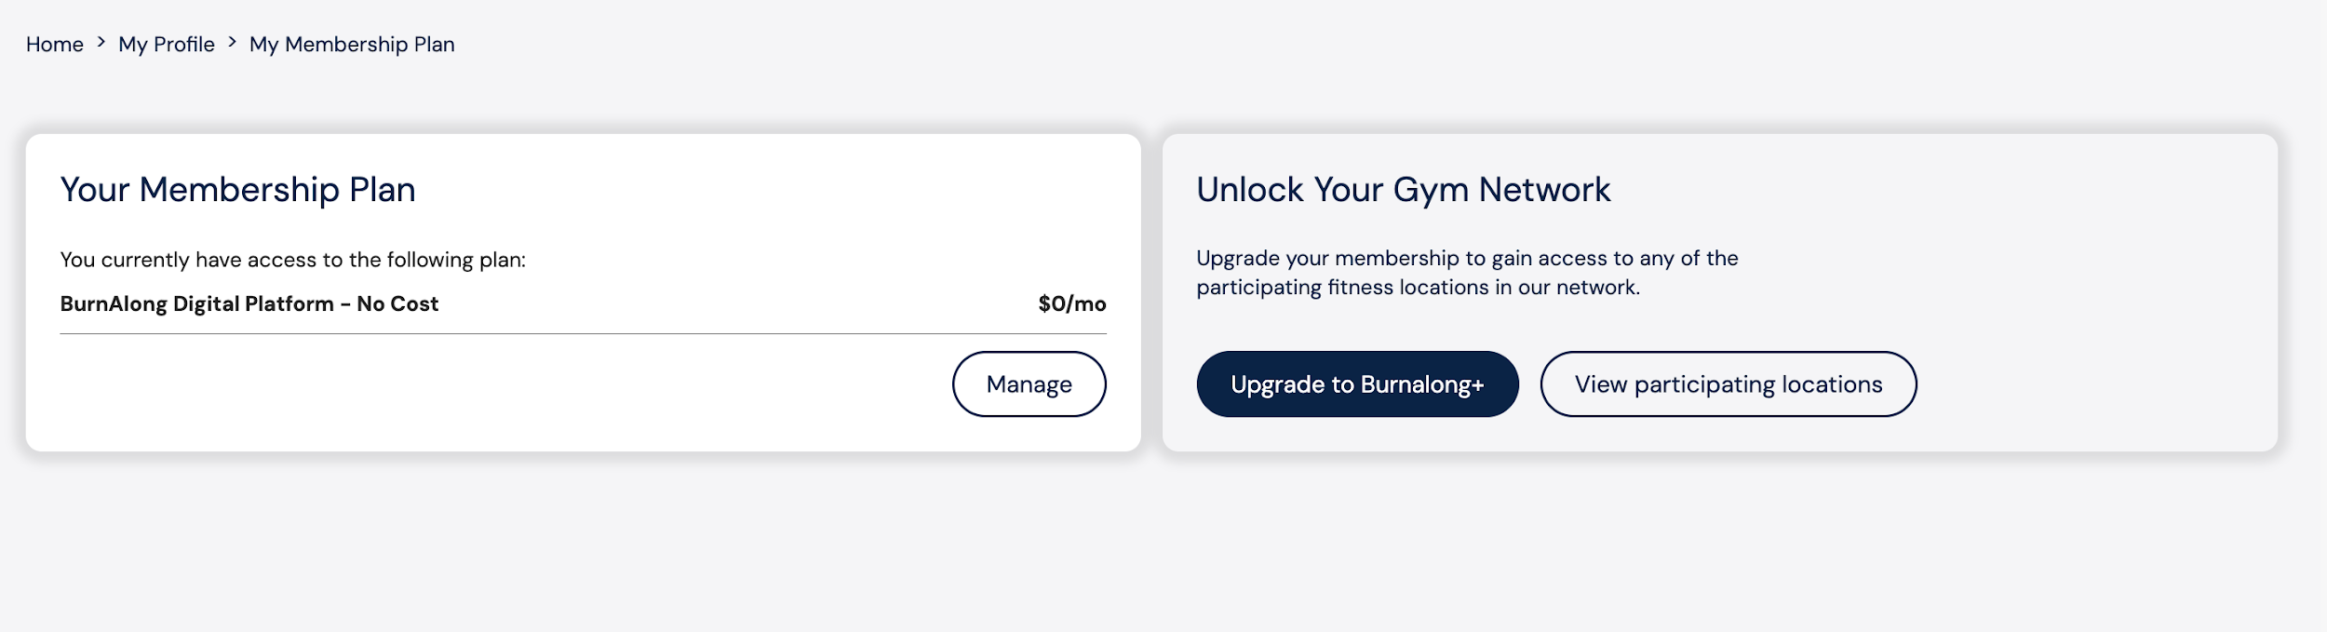
Let me show you how to upgrade
burnalong®, Burnalong is a registered trademark of Burnalong, Inc. © 2024 Burnalong, Inc. All rights reserved. Confidential & Proprietary.

Slide 16

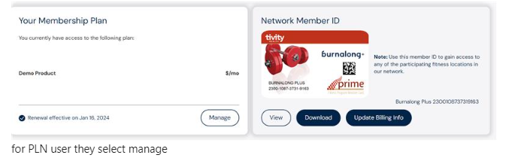
Cancel at anytime
burnalong®, Burnalong is a registered trademark of Burnalong, Inc. © 2024 Burnalong, Inc. All rights reserved. Confidential & Proprietary.

Slide 17







What sounds most like you?
You already go to a gym
Not sure what to do in the gym
Lacking self-esteem
You do not go to a gym because you're not sure what to do to achieve your health goals.
You do not go to a gym because you are intimidated by the gym atmosphere.
You already belong and are loyal to a gym.
1. Access to Fitness locations provided by Tivity Health Services, LLC, an affiliate of Burnalong, Inc. Fitness locations are not owned or operated by Tivity Health or its affiliates. Burnalong+ Subscription with fitness location access option entitles subscriber to use the fitness location facilities and amenities available to the holder of a basic membership at the fitness locations. Facilities and amenities vary by location.
burnalong®, Burnalong is a registered trademark of Burnalong, Inc. © 2024 Burnalong, Inc. All rights reserved. Confidential & Proprietary.

Slide 18

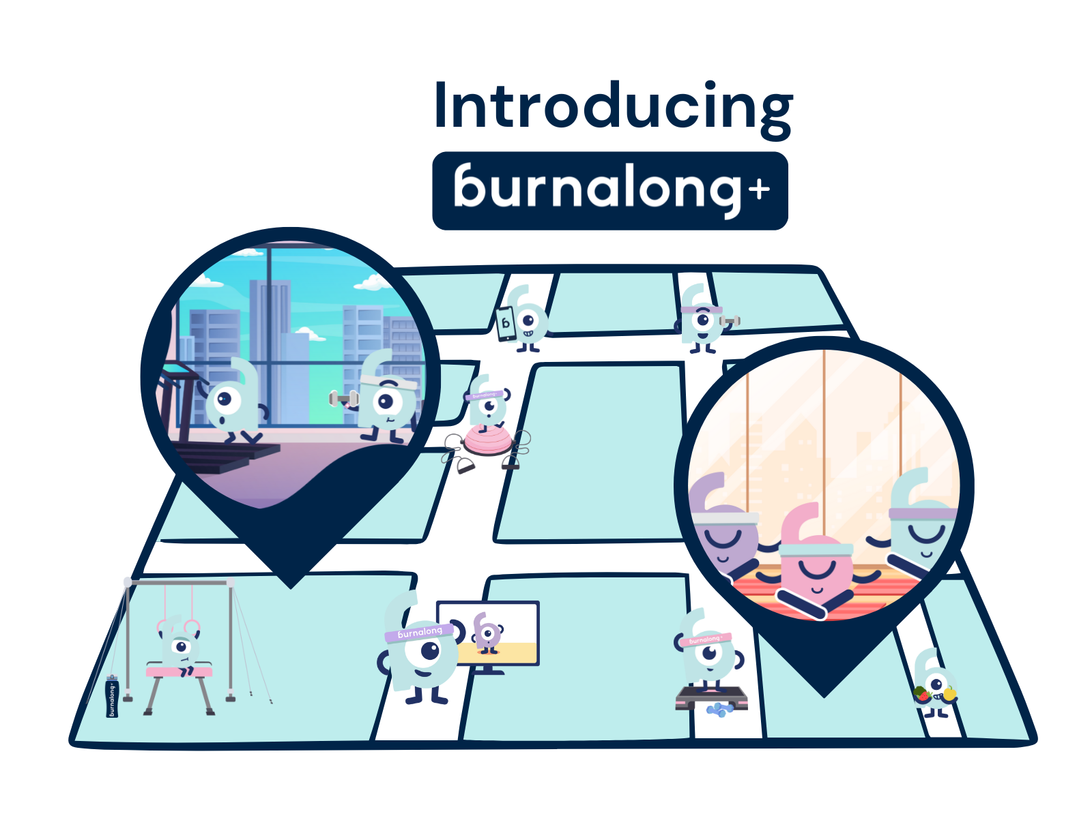


Freedom of choice
1
Visit multiple locations
2
No sign up or cancellation fee
No annual or long-term contract
3
burnalong®, Burnalong is a registered trademark of Burnalong, Inc. © 2024 Burnalong, Inc. All rights reserved. Confidential & Proprietary.
Notes:
Talk track:
Once you have your ID number you are now able to walk into multiple locations in and around wherever you are.
a) Example 1: Workout / Swimming/ class
b) Example 2: When i travel jump on find fitness studio- I walk in
You can say goodbye to all those extra and added fees you pay with gyms and studios with b+ it is one flat fee.
With B+ you are month to month so when you are ready to cancel just cancel no need to feel like you are being held hostage by the gym.

Slide 19
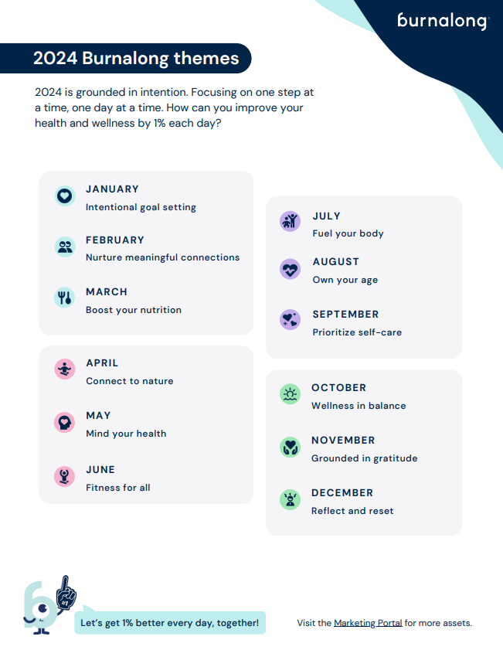
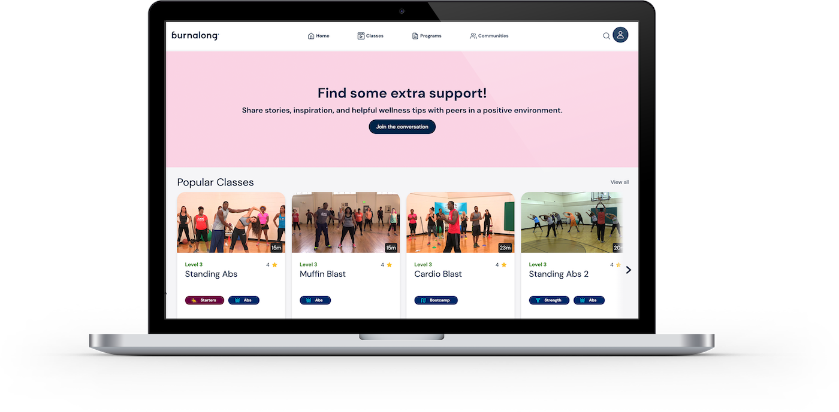
MONTHLY LIVE EVENTS

Slide 20

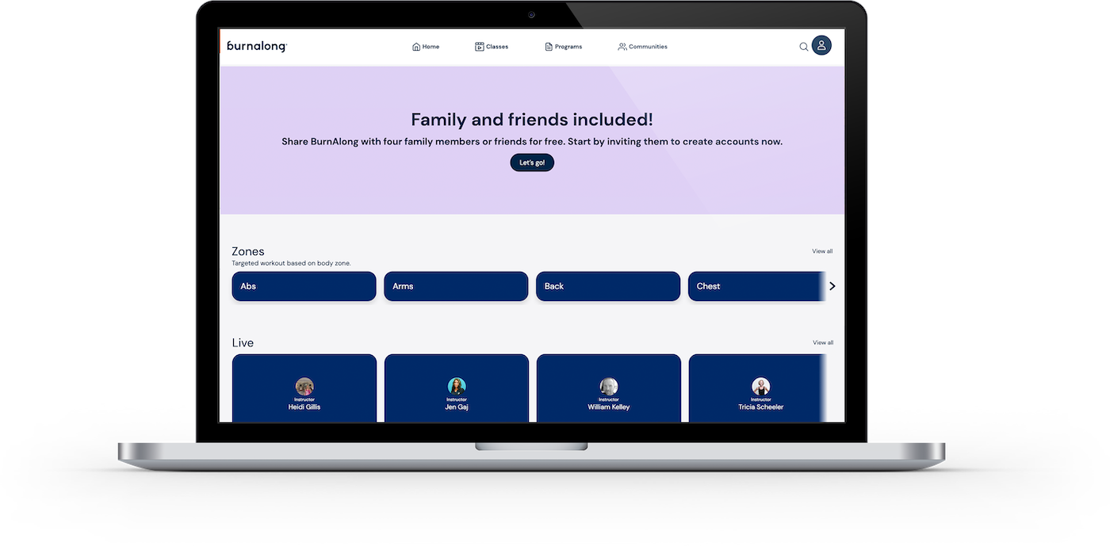
Questions?
CustomerCare@Burnalong.com

